Slide 1
CAPSTONE PROJECT MOBILE PRICE PREDICTION
Sundar K

Slide 2
CONTENT
❑ Introduction
❑ Problem statement
❑ Data Pipeline
❑ Data Description
❑ Exploratory Data Analysis
❑ Model performed
❑ Model Validation
❑ Challenges
❑ Conclusion

Slide 3
Introduction
Mobile phones come in all sorts of prices, features, specifications and all. Price estimation and prediction is an important part of consumer strategy. Deciding on the correct price of a product is very important for the market success of a product. A new product that has to be launched, must have the correct price so that consumers find it appropriate to buy the product.

Slide 4
Problem statement
The data contains information regarding mobile phone features, specifications etc and their price range. The various features and information can be used to predict the price range of a mobile phone.

Slide 5
Data Pipeline
● Exploratory Data Analysis (EDA): In this part we have done some EDA on the features to see the trend.
● Data Processing: In this part we went through each attributes
● Model Creation: Finally in this part we created KNN, Decision Tree and Random Forest models. These model is being analyzed ,so as to get the best performing model for our project.

Slide 6
Data Description
Depented Variable
Price_range- Price of the mobile
Independent Variable
battery_power- Battery Power in mAh
blue- Has BlueTooth or not
clock_speed- Microprocessor clock speed
dual_sim - The phone has dual sim support or not
fc- Front Camera Megapixels
four_g- Has 4G support or not
Int_memory- Internal Memory in GigaBytes
m_dep- Mobile Depth in Cm
mobile_wt- Weight of Mobile Phone

Slide 7
n_cores- Number of cores in the processor
Pc- Primary Camera Megapixels
px_height- Pixel Resolution height
px_width- Pixel resolution width
ram- RAM in MB
sc_h- Mobile screen height in cm
sc_w- Mobile screen width in cm
talk_time- Longest time after a single charge
three_g- 3g or not
touch_screen- Has touch screen or not
Wifi- Has wifi or not

Slide 8
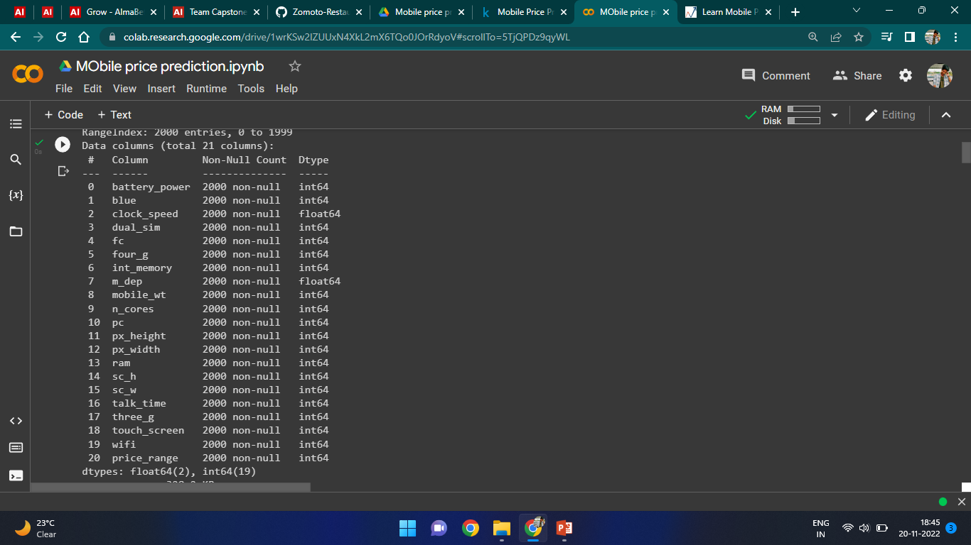
Data features

Slide 9
Data Processing
We have checked for Null values
ds.isnull().sum()
We have checked for duplicate values
len(ds[ds.duplicated()]
)
We have made rename of our dataset so that it can be easily understood

Slide 10
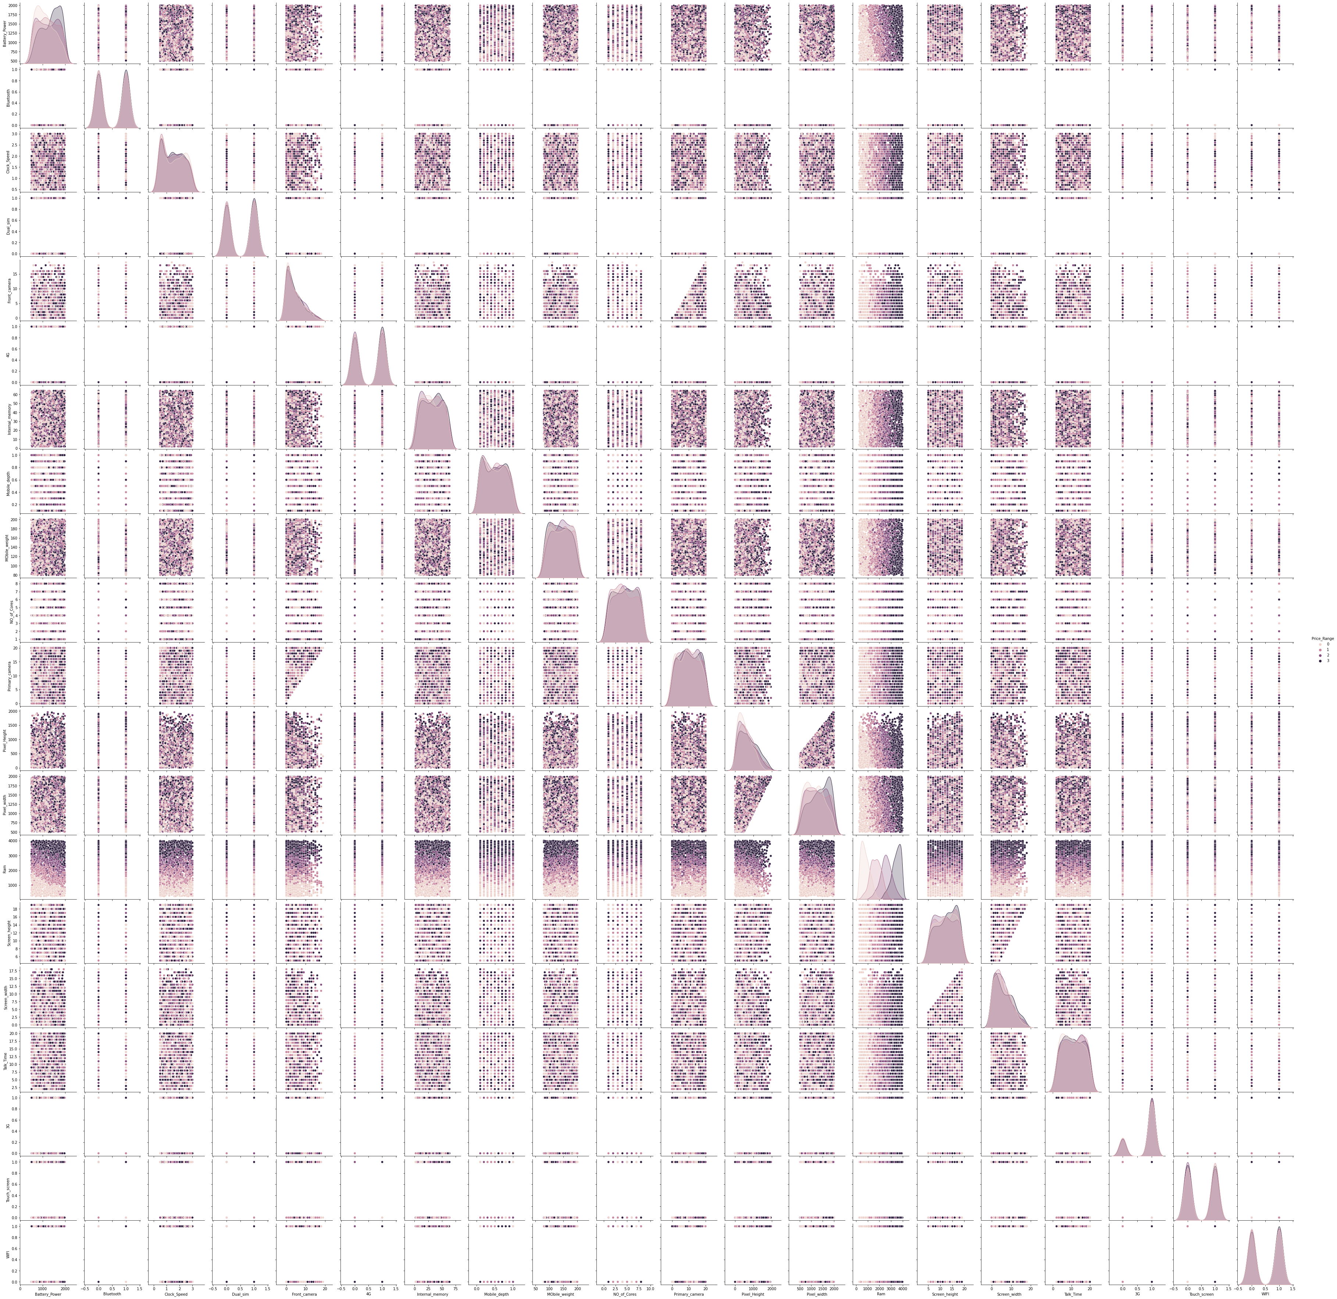
EDA Count Pair plot

Slide 11
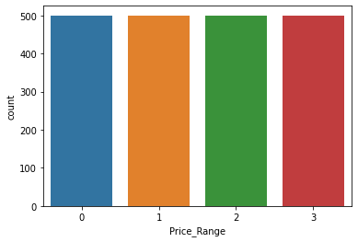
EDA Count Countplot of price range

Slide 12
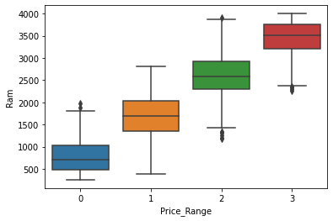
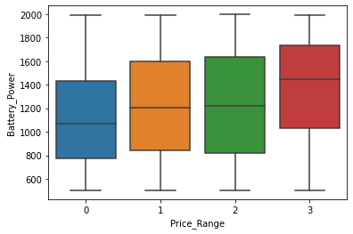
EDA Count
Boxplot of Ram and Battery Power

Slide 13
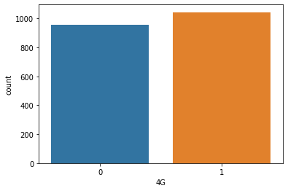
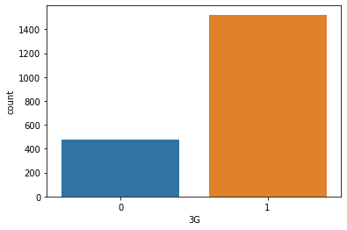
EDA Count
Countplot of 3G and 4G mobiles

Slide 14
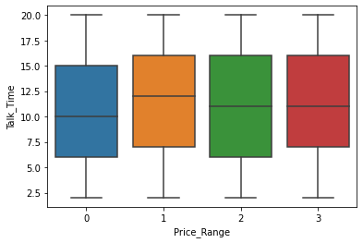
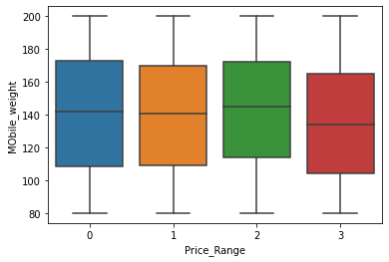
EDA Count
Boxplot of Talk Time and Mobile Weight

Slide 15
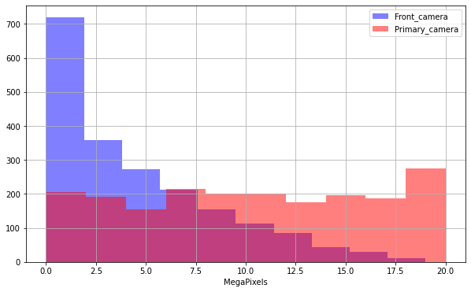
EDA Count
Legend plot of Front and Primary cameras

Slide 16
Models Performed
K-Nearest Neighbour(KNN)
Decision Tree
Random Forest

Slide 17
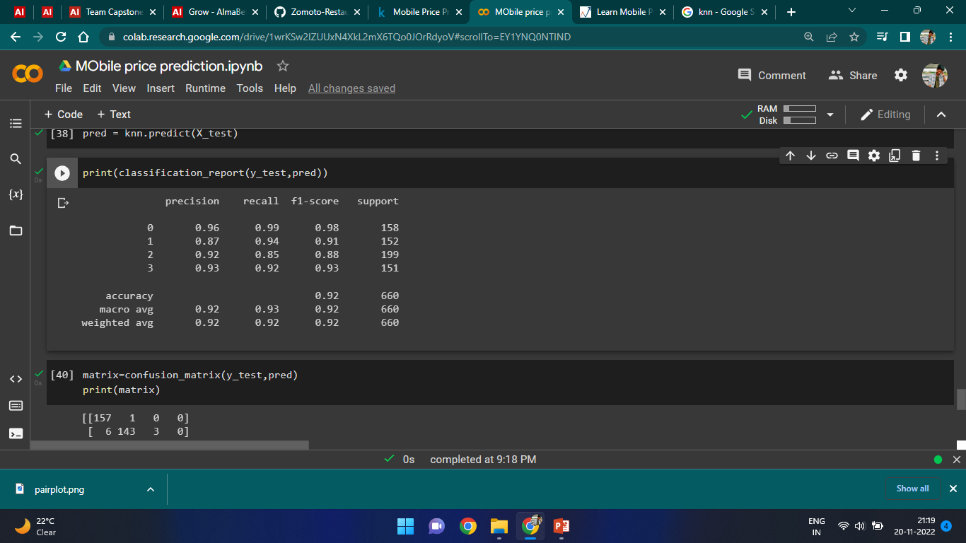
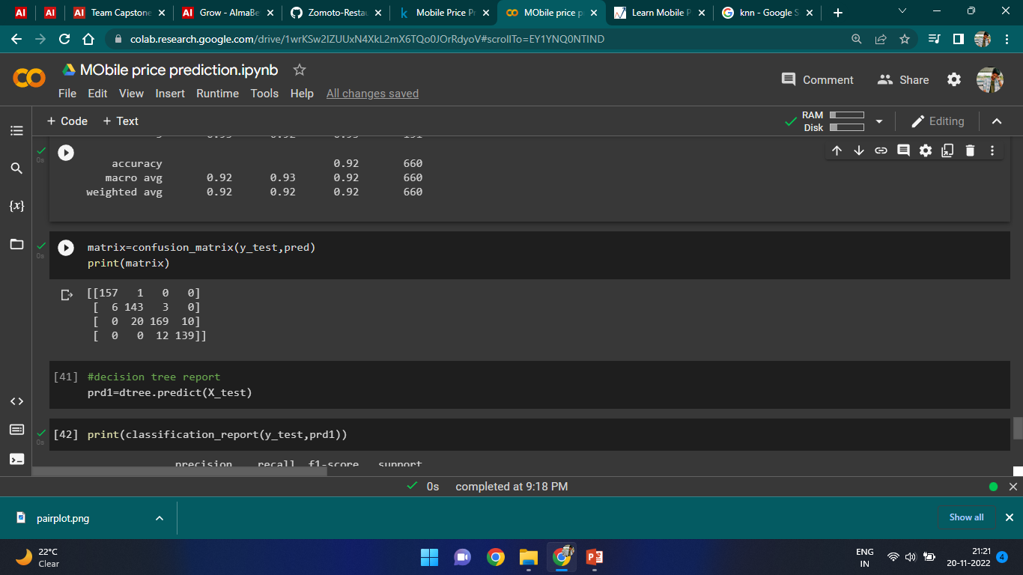
Model Validation K-Nearest Neighbour
Train accuracy : 0.9462686567164179
Test accuracy : 0.9212121212121213

Slide 18
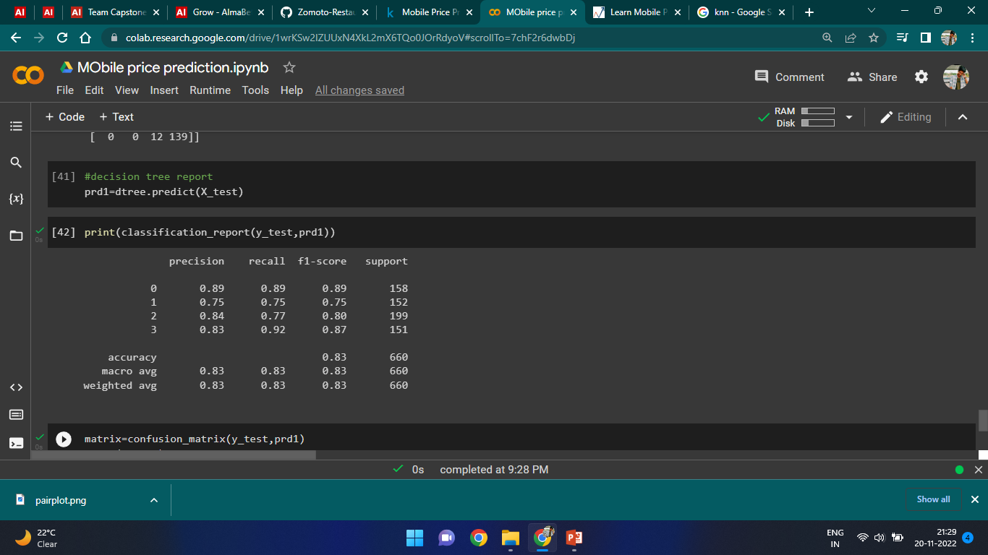
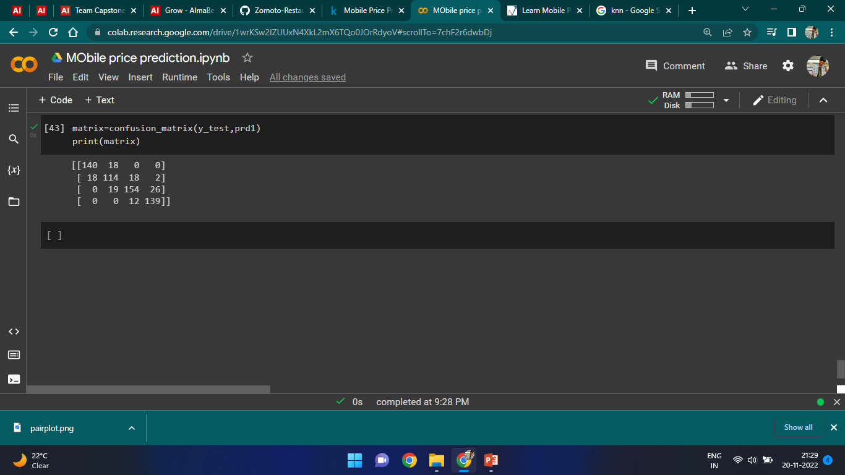
Decision Tree
Train accuracy : 1.0
Test accuracy : 0.8287878787878787

Slide 19
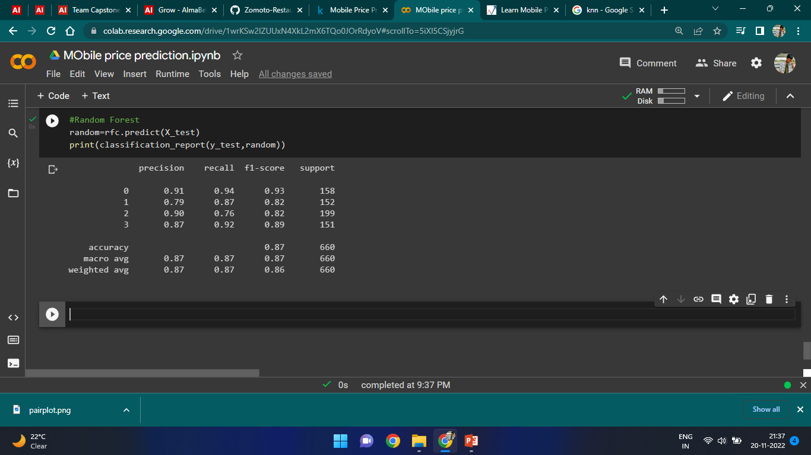
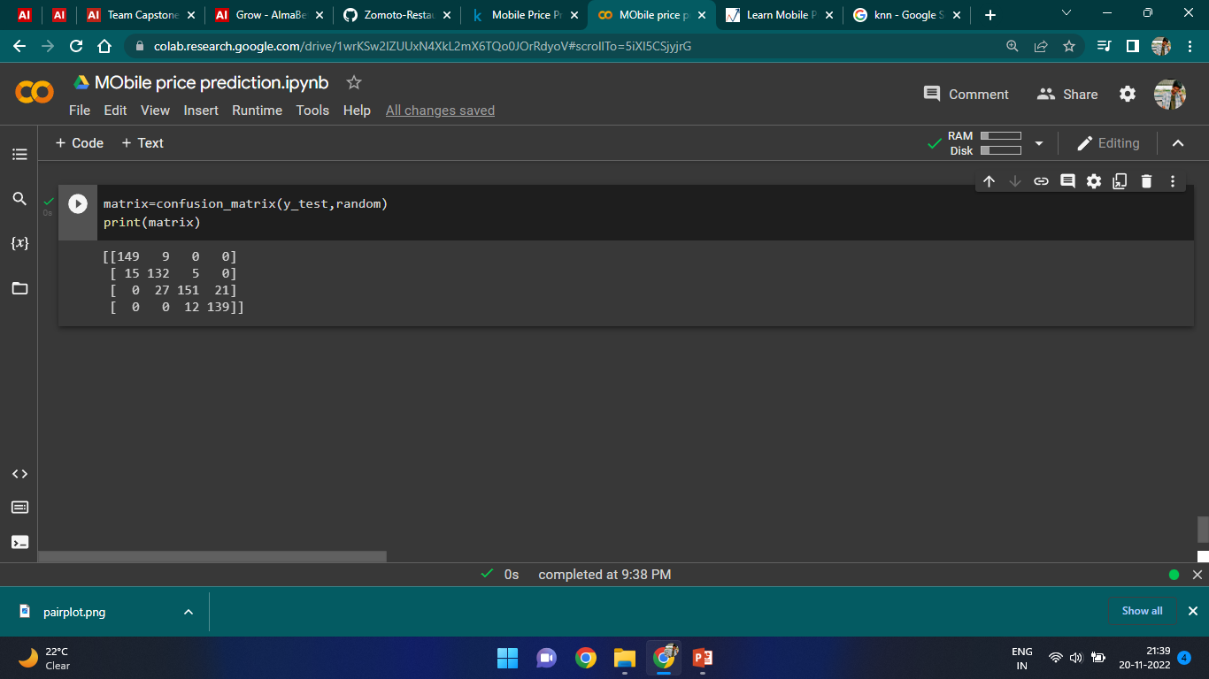
Random Forest
Test accuracy : 0.8651515151515151
Train accuracy : 1.0

Slide 20
Challenges
● A huge amount of data needed to be dealt while doing the project which is quite an important task and also even small inferences need to be kept in mind.
●As dataset was quite big enough which led more computation time.

Slide 21
Conclusion
In this article, we looked at classification. Classifiers represent the intersection of advanced machine theory and practical application. These algorithms are more than just a sorting mechanism for organising unlabeled data instances into distinct groupings. Classifiers include a unique set of dynamic rules that include an interpretation mechanism for dealing with ambiguous or unknown values, all of which are suited to the kind of inputs being analysed. Most classifiers also utilise probability estimates, which enable end-users to adjust data categorization using utility functions.

Slide 22
THANKYOU

